Slide 1

Real Time Anomaly Detection in CCTV Surveillance
Submitted by:-
Avdhesh Chaudhary(02315002719)
Amar Sinha(04415002719)
Chirag Aggarwal(04615002719)
Under the Supervision of
Mr. Vikrant Shokeen

Slide 2
Project Overview
In this project we seek to improvise or make surveillance system more advanced and automated. For this we need to show in which frame and which parts of CCTV footage contain abnormal or suspicious activity . To achieve aforesaid we will be using two different neural networks CNN and RNN.
We will be using InceptionV3 by Google - a pre-trained model to apply the technique of transfer learning. The output of the RNN system is used to perform real-time surveillance on the CCTV cameras of different organizations to avoid and detect any suspicious activity. Hence, the time complexity is reduced to a great extent.

Slide 3
Dataset Fixing
Earlier, the dataset had a greater proportion of anomalous videos as compared to normal videos. Such a dataset would have led to lots of “False Positive” and eventually resulting in lower precision, this was fixed by adding more normal videos to the dataset, restructuring the dataset and eventually making a customized train-test split for the same.

Slide 4
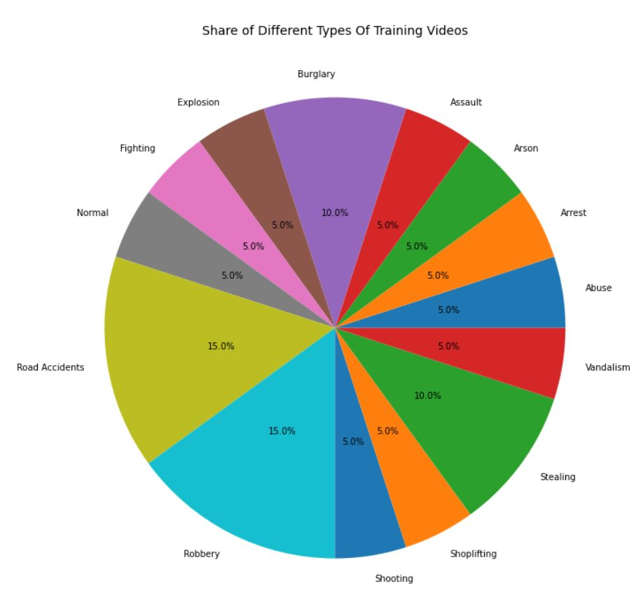
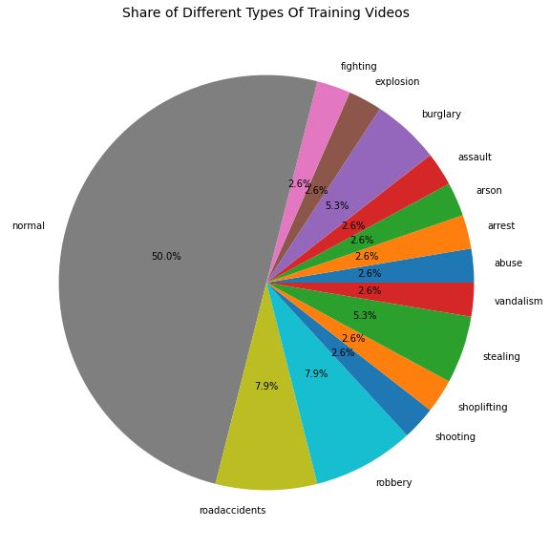
Earlier dataset
Updated dataset

Slide 5
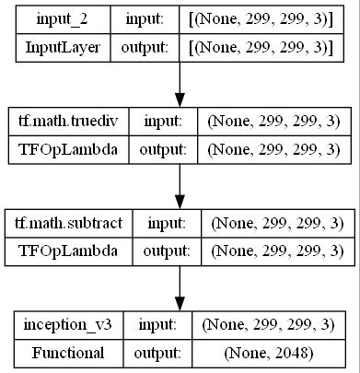
Transfer learning and feature Extraction
Post conversion from videos to frames, each frame was fed to CNN where, the feature extraction network is typically a pretrained InceptionV3 architecture. The first subnetwork is a region proposal network trained to classify objects from the background, and the second subnetwork is trained to classify the detected objects’ action alone (assault, arrest, abuse, normal etc.).

Slide 6
CNN Model Working
The output of the Inception model is passed to the input of the CNN which isn't the final classification model. Rather, the outcome of the last pooling layer is extracted which is a vector containing 2,048 features to feed as an input to RNN. The vector is referred to as a high-level feature map.

Slide 7
Grouping of feature maps into a single pattern
To give the framework a sense of the sequence, multiple prepossessed frames are considered. This chunk is then used to make the final classification. A chunk of these frames classifies a temporal segment of the video and can provide a sense of motion. For this, some feature maps are stored which are predicted by the inception model (CNN), generated in that fixed period of the video. Low-level features have been considered to generate a high-level feature map. These features are used for finding shapes and objects in computer images. This single combined feature map is then passed to the RNN. The reason to pass the feature map instead of the frame itself is to reduce the training complexity of the RNN. Next Step

Slide 8
Thank You

